Slide 1


Slide 1
YOUR HEALTHY CAFÉ
IN SINGAPORE
INVESTOR OPPORTUNITY

Slide 2
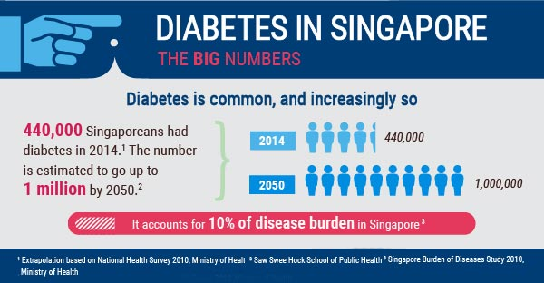

Slide 13
BACKGROUND
About 400,000 Singaporeans are diabetes and one in three has lifetime risk of developing the disease.
And if nothing is done, the number of diabetes under age 70 is expected to rise to 670,000 by 2030 and one million by 2050.
Singapore government adopts a multi-pronged strategy to encourage Singaporeans to eat healthily and reduce their sugar intake from foods and drinks.
Coffee is one of the common sugar intakes for Singaporean. We are going to open a café to serve coffee with less sugar and food with balanced nutrition.

Slide 3

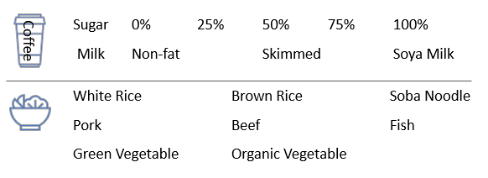
Slide 2
OUR BIG IDEA
Your Coffee Shop’s mission is to provide healthy meal for office clerks in a rushing pace for business. They can have a healthy choice of meal in a convenient place. Perhaps breakfast before work, lunch break during working hour, a quick dinner after work or before going to gym, or a power-up after exercise.

Slide 4



Explore Singapore Market
Mission: Find out a suitable location for healthy café
Allocate business area
Find out the crowd with healthy awareness
Avoid competitors

Slide 5
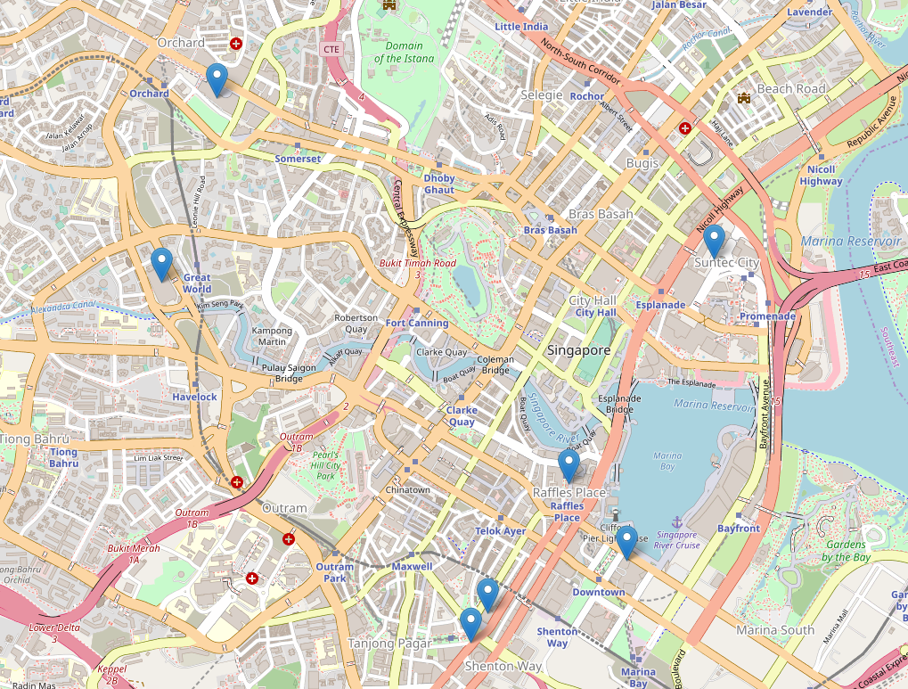
Singapore 7 Popular Business Area
Collect geocodes from google map API.
Area | Landmark | Latitude | Longitude
Raffles Place Area | Raffles Place MRT | 1.283969 | 103.8515
Marina Bay Area | Marina Bay Finacial Centre | 1.280283 | 103.8543
Tanjong Pagar / Anson Road | Tanjong Pagar MRT | 1.276342 | 103.8468
Orchard Road Area | Ngee Ann City | 1.302557 | 103.8346
Shenton Way Area | Capital Tower | 1.277737 | 103.8476
River Valley | Great World City | 1.293642 | 103.8319
Suntec City | Suntec City | 1.29478 | 103.8585
Orchard Road
Suntec City
River Valley
Raffles Place
Shenton Way
Marina Bay
Tanjong Pagar
Reference
https://www.corporateservicessingapore.com/7-popular-business-locations-singapore/

Slide 6

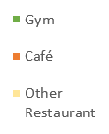

Nearby Venues in Each Business Area
Collect venue list for each business area. Calculate the distribution among gyms, café and other restaurant.
Tire 1 Area
Density of gyms is high.
Competitive index is low.
Let’s select “Shenton Way”
with lowest competitive index.
Competitive
Index
357
372
379
Competitive
Index
625
800
838
855
Café is the direct competitor
Competitive Index = (Count of Café + Count of other restaurant * 0.5) / (Count of gyms) * 100.
It shows the level of competitors in each location. The lower the better.
Reference
https://developer.foursquare.com/

Slide 7
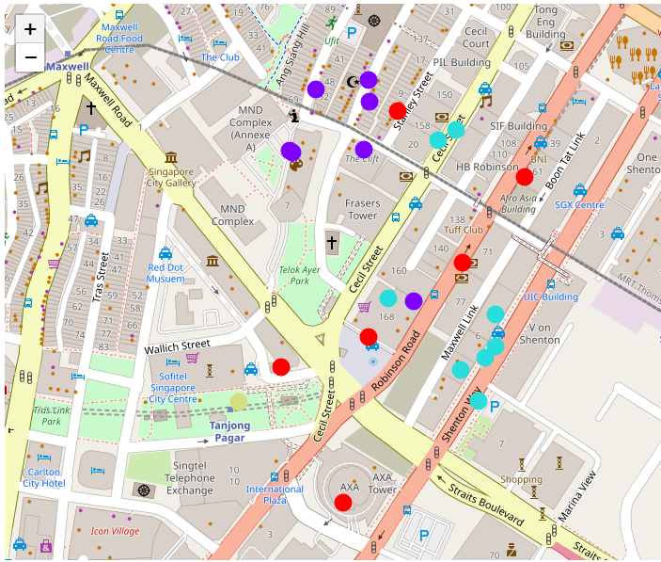
Explore Shenton Way
Based on location and nearby venues, we can classify gyms in Shenton Way area into 4 clusters#.
Cluster | Avg. Count of Gyms Nearby (Main Target Customers) | Avg. Count of Café Nearby (Direct Competitors) | Avg. Count of Other Restaurants Nearby (Relatively Indirect Competitors)
1 | 1.2 | 3.3 | 1.3
2 | 2.4 | 2.3 | 4.7
3 | 2.4 | 1.0 | 0.8
4 | 1.0 | 7.0 | 9.0
Result 2
Result 1
Cluster | Avg. Count of Gyms Nearby (Main Target Customers) | Avg. Count of Café Nearby (Direct Competitors) | Avg. Count of Other Restaurants Nearby (Relatively Indirect Competitors)
1 | Medium | Medium | Low
2 | High | Medium | High
3 | High | Low | Low
4 | Low | High | Very High
 | Cluster 1
 | Cluster 2
 | Cluster 3
 | Cluster 4
Based on the classification result, there are two ideal locations highlighted in map.
Let’s start to search if there’s any available rent in these two places.
Reference
https://developer.foursquare.com/
# Classification was done by KNN method.

Slide 8
Conclusion
Searched 7 Singapore popular business area.
We can find out below areas with more gyms and relatively low density of café.
Shenton Way area is the first choice while Tanjong Pagar and Raffles Place can be backup choices.
When we start to explore Shenton Way, we can find out two ideal locations.
First one is the east side of Maxwell Link with 5 gyms nearby.
Second one is north side of Cecil Street.
Result 2
Result 1
 | Cluster 1
 | Cluster 2
 | Cluster 3
 | Cluster 4

Slide 9

Slide 15
THANK YOU!
CONTACT US AT:
Sha Yanyan
shayy07@163.com

Slide 10
Appendix

Slide 11
Gyms in Shenton Way
Venue | Avg. Count of Gyms Nearby (Main Target Customers) | Avg. Count of Café Nearby (Direct Competitors) | Avg. Count of Other Restaurants Nearby (Relatively Indirect Competitors) | Latitude | Longitude | Cluster
Anytime Fitness | 1 | 7 | 9 | 1.276658 | 103.845944 | 4
Anytime Fitness Cecil Street | 2 | 1 | 0 | 1.279642 | 103.848224 | 3
Boulder Movement | 2 | 1 | 2 | 1.277651 | 103.84888 | 3
Sweatbox | 2 | 1 | 0 | 1.276672 | 103.84869 | 3
Fitness First Platinum | 2 | 1 | 2 | 1.277843 | 103.847654 | 3
Freedom Yoga | 2 | 0 | 0 | 1.279755 | 103.848431 | 3
STILL | 3 | 2 | 2 | 1.277296 | 103.848878 | 3
GuavaLabs | 3 | 1 | 0 | 1.277162 | 103.84876 | 3
Haus Athletics | 3 | 1 | 0 | 1.277023 | 103.848485 | 3
Uppercut Boxing | 3 | 2 | 5 | 1.28033 | 103.847431 | 2
URA Gymnasium @ 4th Floor | 2 | 1 | 4 | 1.279526 | 103.846526 | 2
Hale Yoga Studio | 2 | 2 | 3 | 1.277811 | 103.847943 | 2
Gym @ The Clift | 1 | 3 | 5 | 1.279529 | 103.847373 | 2
Fitness Chemistry | 2 | 1 | 4 | 1.279504 | 103.84656 | 2
Bodytec Studio | 4 | 3 | 6 | 1.280082 | 103.847438 | 2
Athlete Lab | 3 | 4 | 6 | 1.280222 | 103.846832 | 2
Radiance PhysioFit | 1 | 4 | 0 | 1.27551 | 103.847142 | 1
Ritual Gym | 1 | 3 | 0 | 1.27824 | 103.848499 | 1
GIC Gym Studio | 1 | 4 | 2 | 1.277402 | 103.847426 | 1
Vanda Boxing Club | 1 | 2 | 1 | 1.279218 | 103.849207 | 1
Virgin Active | 1 | 4 | 3 | 1.277055 | 103.846435 | 1
Webarre | 2 | 3 | 2 | 1.279975 | 103.84776 | 1

